Slide 1
Sense & Avoid Introduction: Airspace classification UAS Traffic Management Terminology Reactive Avoidance
Notes:
That was story folks !
Now lets get to the serious talks!
I will introduce terms and process of Obstacle Avoidance

Slide 2
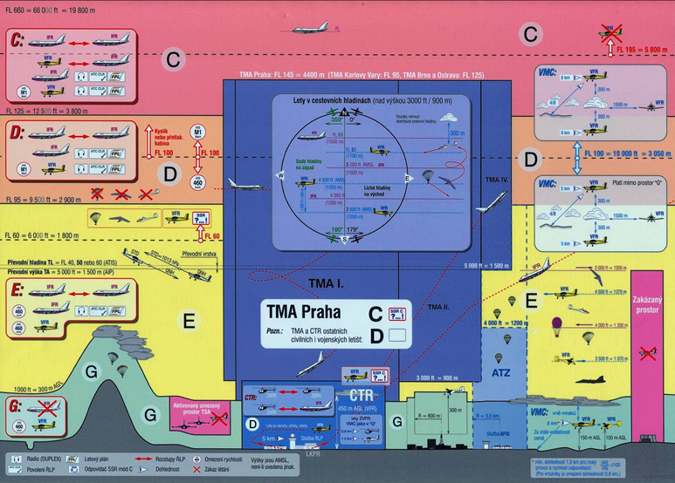
Context of SAA: Airspace classification (2.2)

Slide 3
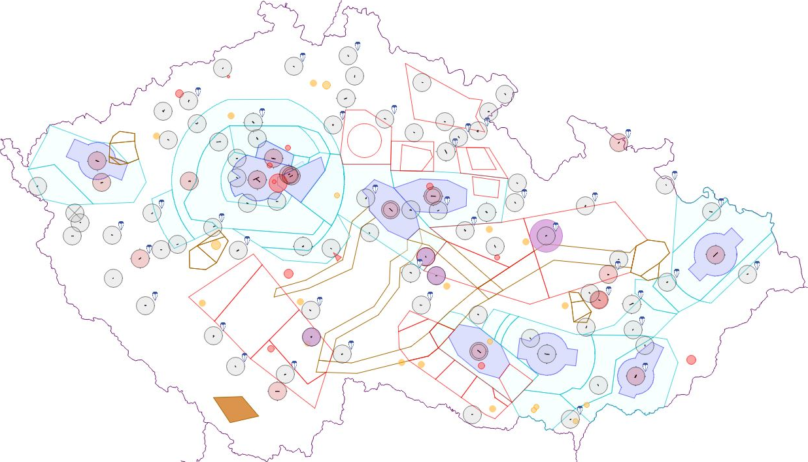
Context of SAA: Airspace restrictions (2.3)
Airport
Control zone
Temporary area
*Example of air traffic constraints is taken from Czech national air traffic control portal (http://aisview.rlp.cz/)

Slide 4
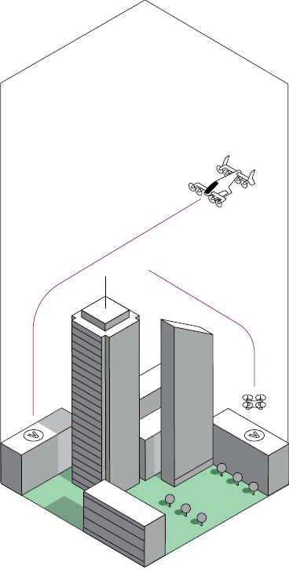
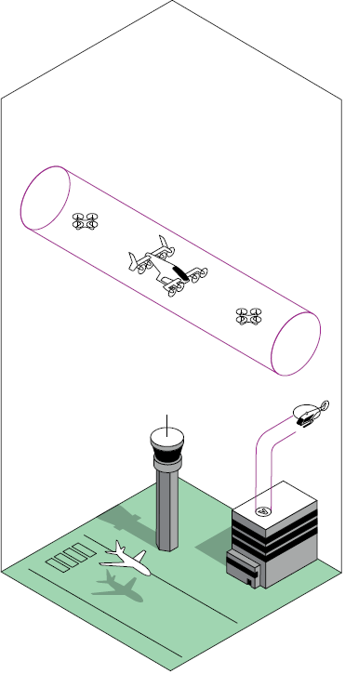
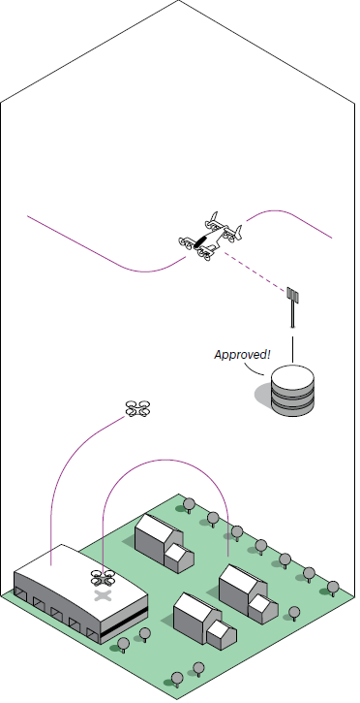
Context of SAA: UAS Traffic Management (UTM) (2.5)
a

Slide 5
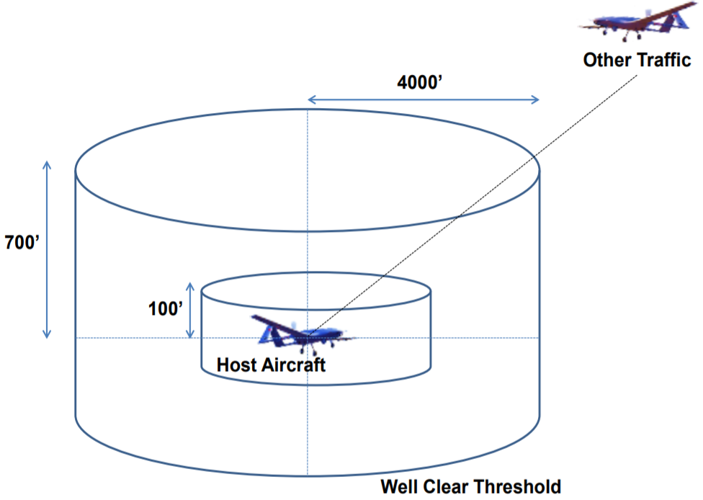
Context of SAA: Goal in controlled airspace: Remain well clear

Slide 6




Context of SAA: Actors introduction
UAS
Adversary
Intruder
Static obstacle
Notes:
Our main focus is to keep UAS safe while doing its business ,
There are Intruder planes which tell us where we are and tries to not harm UAS
Next are not so kind Adversaries which do not care about UAS nor Active avoidance
Then there is the greatest enemy of UAS, everlasting ground and its related obstacles.

Slide 7
Context of SAA: Reactive Sense & Avoid
Field of Vision
(FOV)
Obstacle
Waypoint
$$W_{1}$$
Avoidance execution
Reactive obstacle avoidance
Obstacle detection
Waypoint
$$W_{3}$$
Waypoint
$$W_{2}$$
Planned path
Notes:
UAS is flying some mission given by set of navigation waypoints
Obstacle enters into Field of Vision,
Our algorithm for “Reactive” obstacle is triggered.
UAS will avoid the danger and safely finishes the mission

